Slide 1
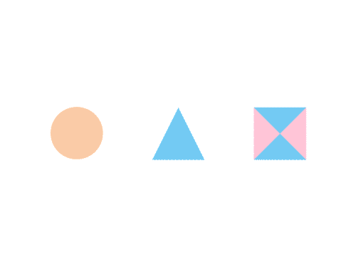

CSE 591 Introduction to Scientific Visualization
Ross Maciejewski
rmacieje@asu.edu

Slide 2
The Importance of Knowing Your Data
Everything you do to create an image relies on characteristics of your data !!
You should know the following:
Data source
Data characteristics
Representation
Transformations
Quality
Slides borrowed from Dr. David S. Ebert

Slide 3
Data Sources
The capability of traditional presentation techniques is not sufficient for the increasing amount of data to be interpreted
Data might come from any source with almost arbitrary size
Techniques to efficiently visualize large-scale data sets and new data types need to be developed
Slides borrowed from Dr. David S. Ebert

Slide 4
Data Sources
Real world
Measurements and observation
Theoretical world
Mathematical and technical models
Computational models
Artificial world
Data that is designed
Slides borrowed from Dr. David S. Ebert

Slide 5
Data Sources
Measurement
Medical imaging (MRI, CT, PET)
Geology (e.g. oil exploration)
Meteorology and environment (satellites)
Astronomy (e.g. Hubble Space Telescope 100MB/day)
Atomic Force Microscopes, Electron Microscopes
Slides borrowed from Dr. David S. Ebert

Slide 6
Data Sources
Computer simulations
Computational fluid mechanics (CFD)
Structural mechanics
Car body design
Chemistry and biology (molecular modeling)
Physics (Astrophysics, computational physics)
Computational nanoelectronics
Slides borrowed from Dr. David S. Ebert

Slide 7
Data characteristics
Spatial data
Scalar
Vector
Volumetrically varying
Time varying
Non-spatial data
Probability distributions
Uncertainty information
Accuracy, error
Statistical information
Slides borrowed from Dr. David S. Ebert

Slide 8
Data Characteristics
Continuity
Structure
Dimensions
Values per sample point
Type
Scale
Slides borrowed from Dr. David S. Ebert

Slide 9
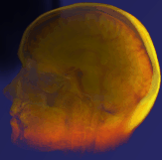
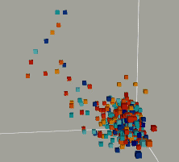
Characterization of Visualization Problems
Characterized by type of data and dimensionality
Medical easiest
Scientific
Information hardest
Slides borrowed from Dr. David S. Ebert

Slide 10
Visualization Problems vs. Data Types
Medical
Scientific
Information
2D
3D
n D
2D
3D
Structured
Unstructured
Structured
Scalar
Vector
Tensor
Scalar
Vector
Tensor
Slides borrowed from Dr. David S. Ebert

Slide 11
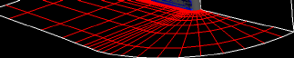
Data Types and Characteristics
Structure
Structured
Voxel
Rectilinear
Curvilinear
Slides borrowed from Dr. David S. Ebert

Slide 12

Data Types and Characteristics
Structure
Unstructured
Tetrahedral
Slides borrowed from Dr. David S. Ebert

Slide 13
Data Types and Characteristics
Dimensionality
2D
Surfaces vs. points. vs. lines
3D
Scalar vs. vector
n D
n D space vs. multiple 3D values (e.g., CT, MR)
Slides borrowed from Dr. David S. Ebert

Slide 14
Data Types and Characteristics
Scalar vs. vector
Scalar easier to represent
Vectors require more information to be displayed
Directionality
Slides borrowed from Dr. David S. Ebert

Slide 15
Characterization of Visualization Techniques
2D Data:
Line plots
Scatter plots
Charts
Slides borrowed from Dr. David S. Ebert

Slide 16
Characterization of Visualization Techniques
3D Data:
Streamlines
Particle traces
Isosurfaces
Glyph rendering
Volume rendering
Slides borrowed from Dr. David S. Ebert

Slide 17
Characterization of Visualization Techniques
3D data: streamlines
Lines that trace out flow
Mainly used for flow visualization
Slides borrowed from Dr. David S. Ebert

Slide 18
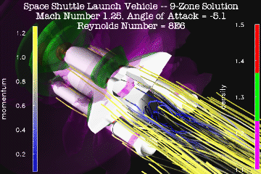
Characterization of Visualization Techniques
3D data: streamlines
Slides borrowed from Dr. David S. Ebert

Slide 19
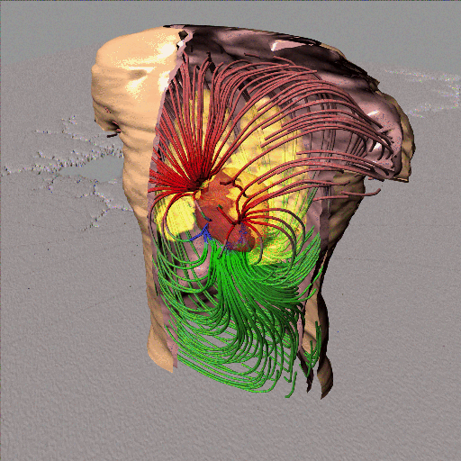
Streamlines
Slides borrowed from Dr. David S. Ebert

Slide 20
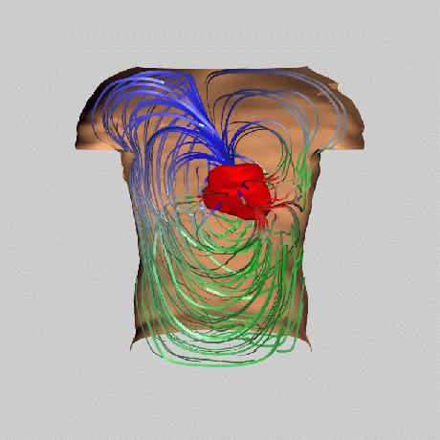
Ribbons
Slides borrowed from Dr. David S. Ebert

Slide 21
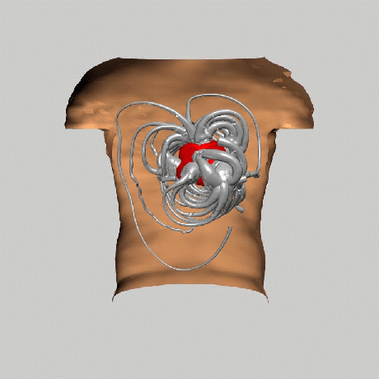
Rubber Tubes
Slides borrowed from Dr. David S. Ebert

Slide 22
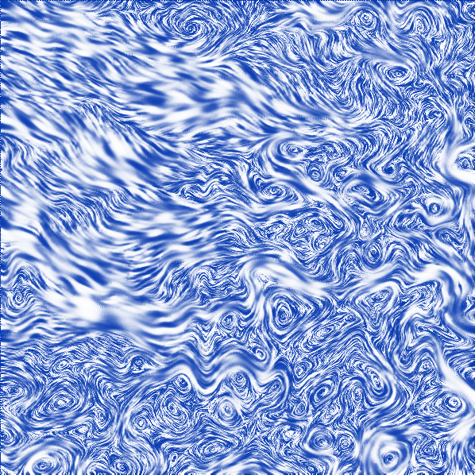
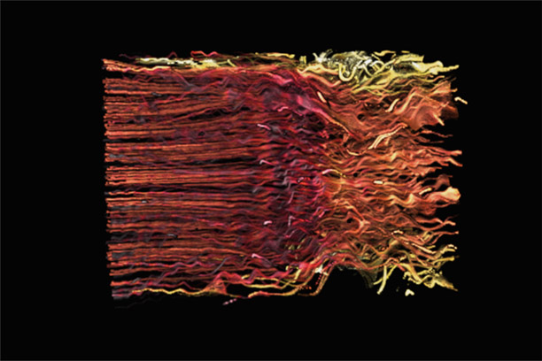
LIC Flow (Banks and Interrante)
Slides borrowed from Dr. David S. Ebert

Slide 23
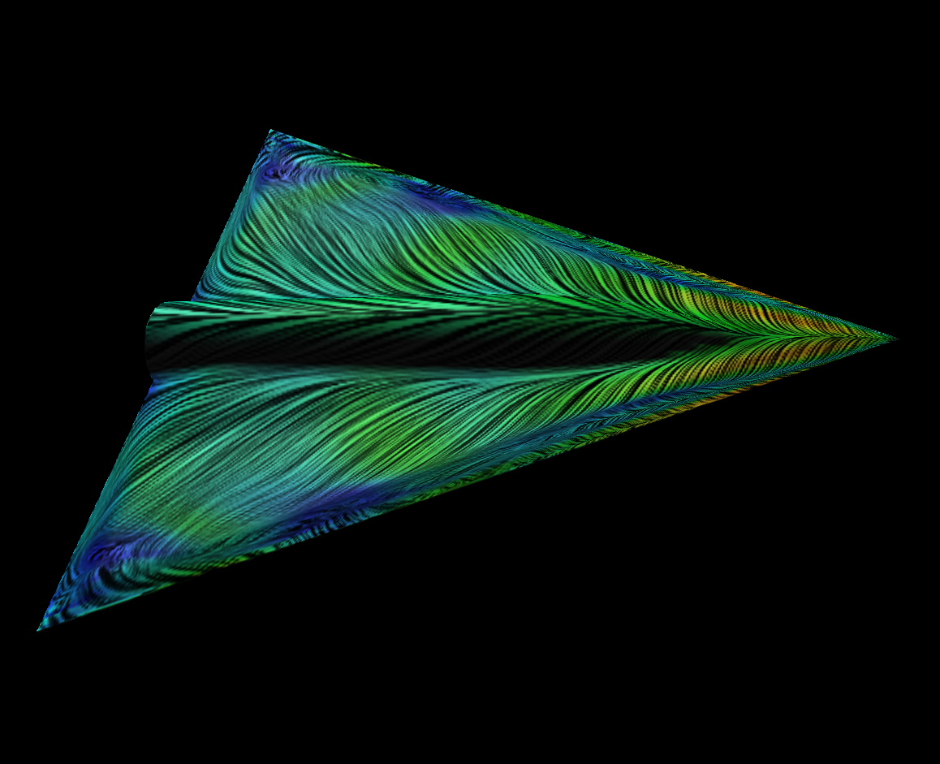
LIC
Slides borrowed from Dr. David S. Ebert

Slide 24
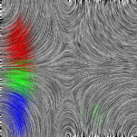
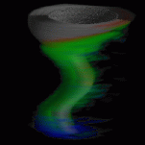
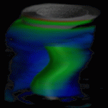
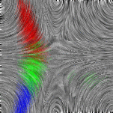
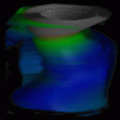
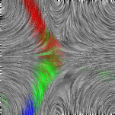
LIC and Dye Advection
Slides borrowed from Dr. David S. Ebert

Slide 25
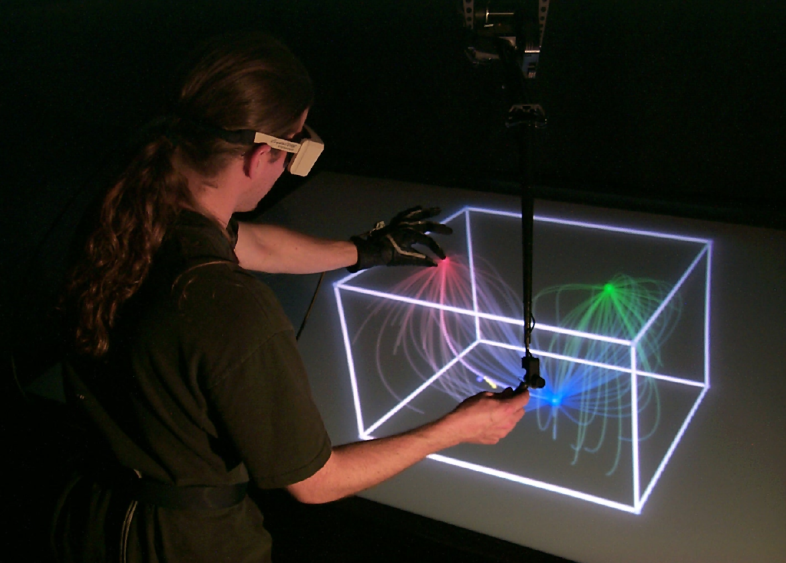
Vector Fields Direct Manipulation Widgets/Haptics
Slides borrowed from Dr. David S. Ebert

Slide 26
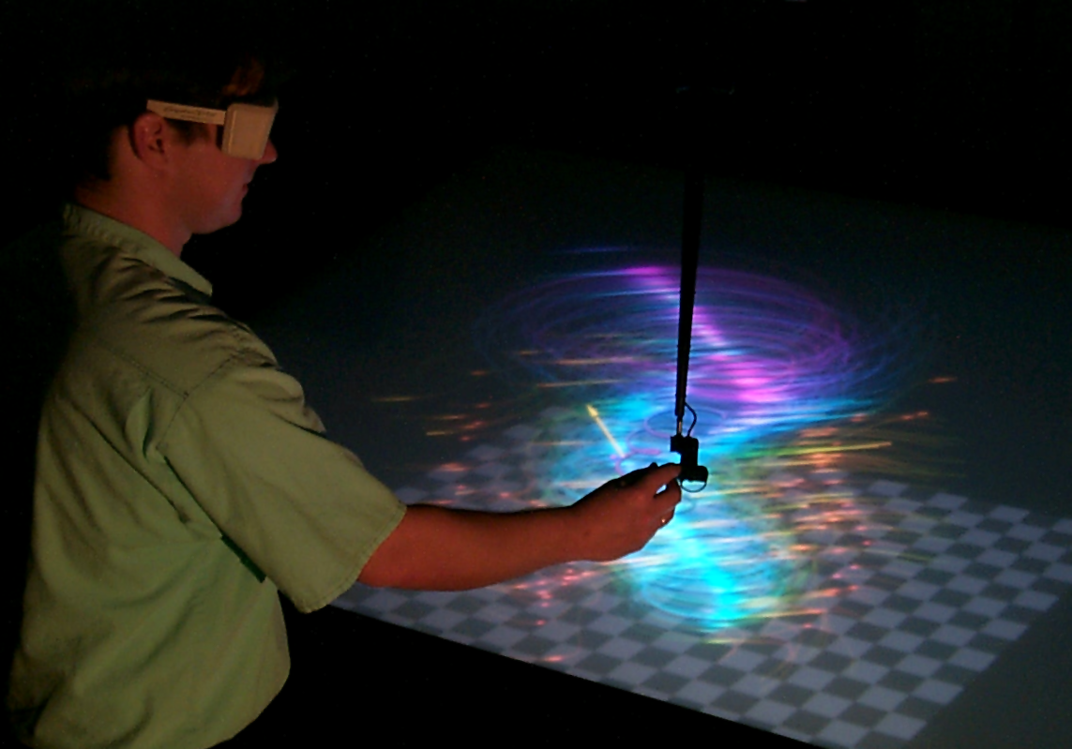
Multiple Fields - Haptics
Slides borrowed from Dr. David S. Ebert

Slide 27
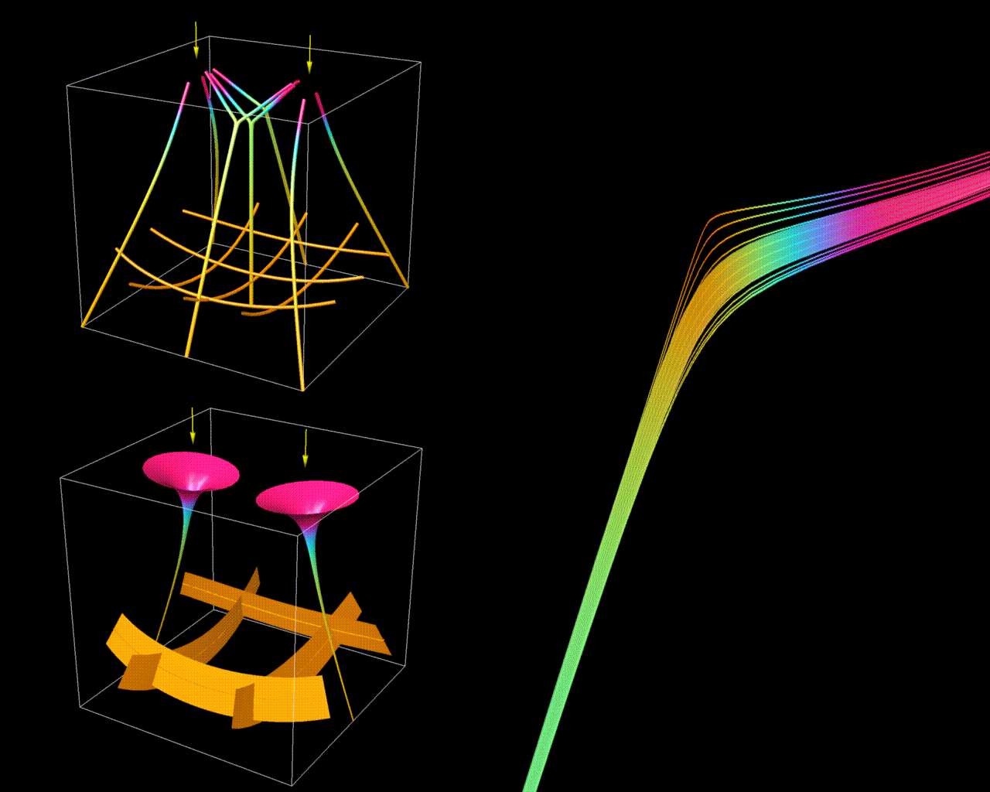
Tensor Fields
Slides borrowed from Dr. David S. Ebert

Slide 28
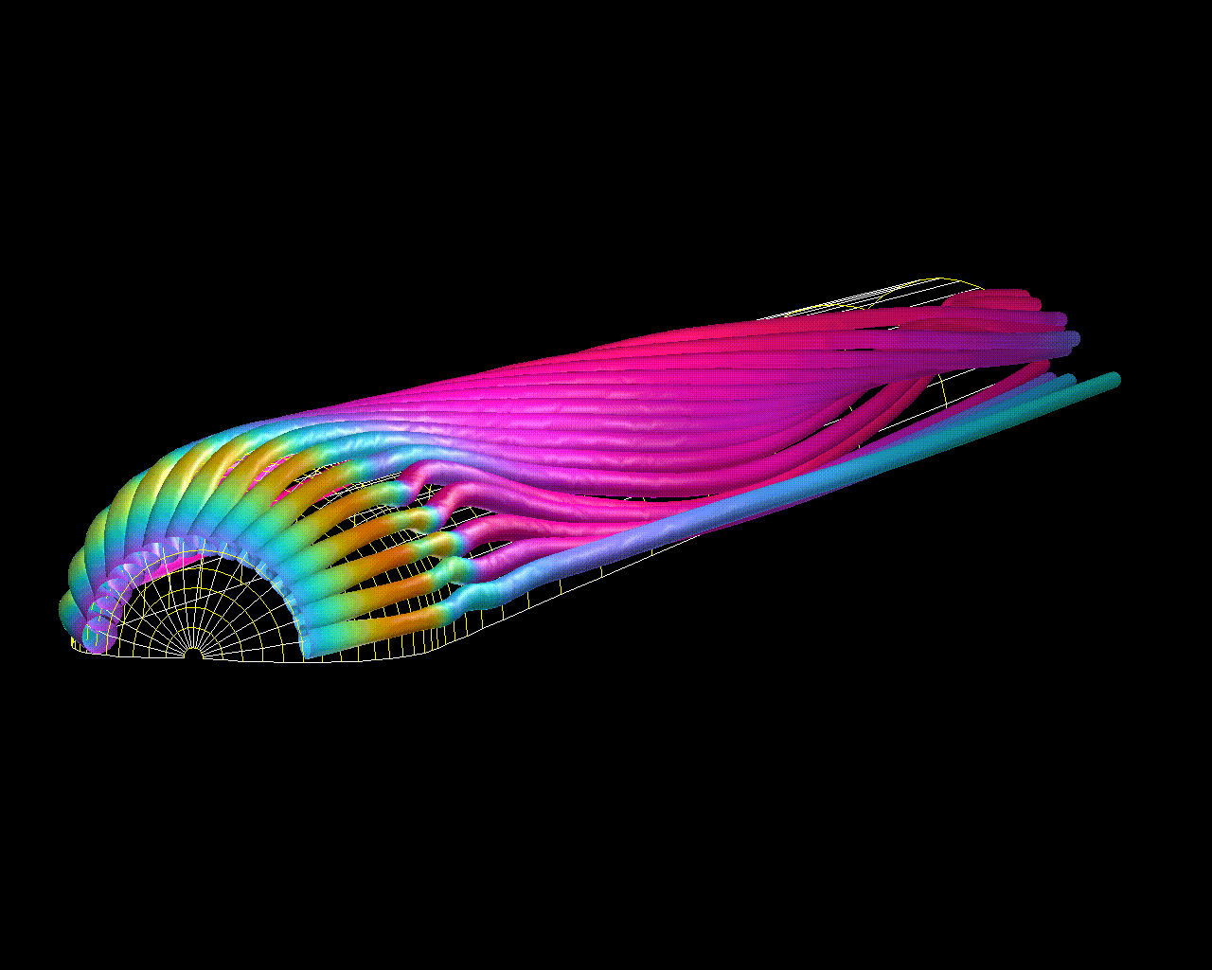
Hyperstreamlines
Slides borrowed from Dr. David S. Ebert

Slide 29
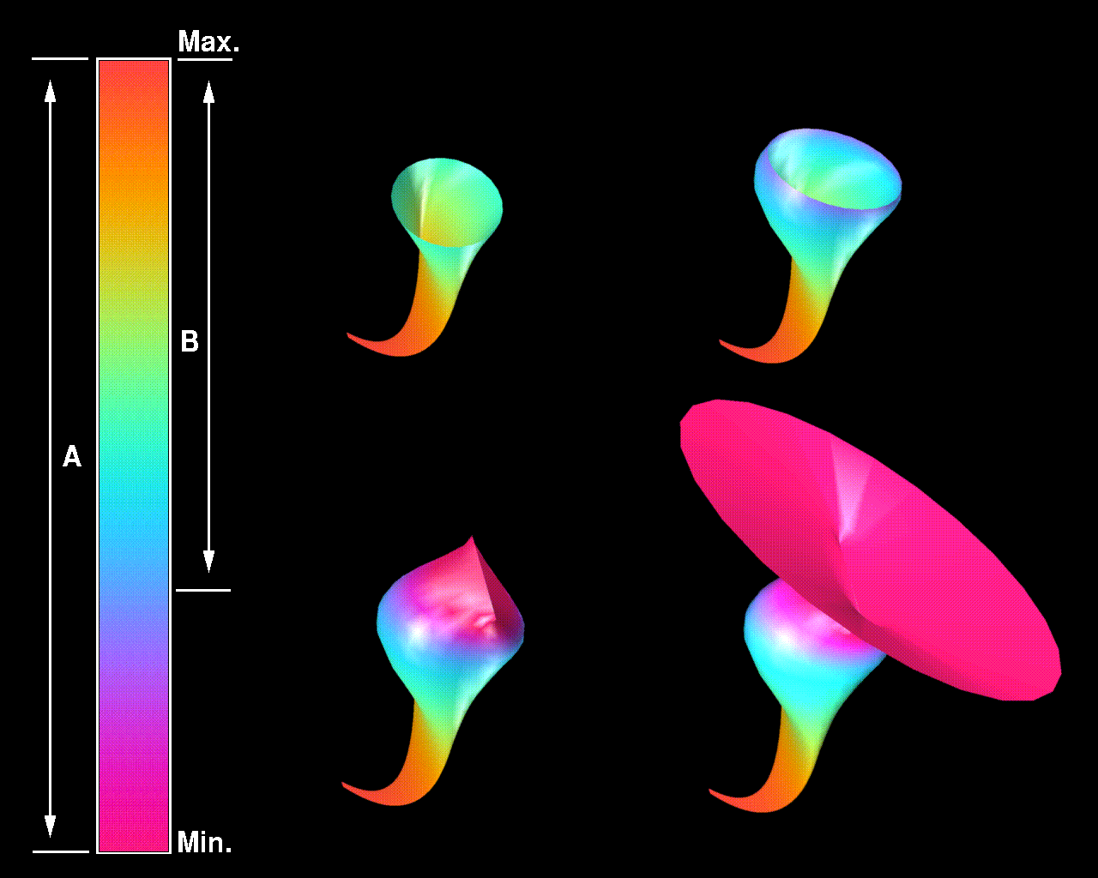
Hypersurfaces
Slides borrowed from Dr. David S. Ebert

Slide 30
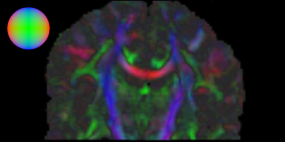
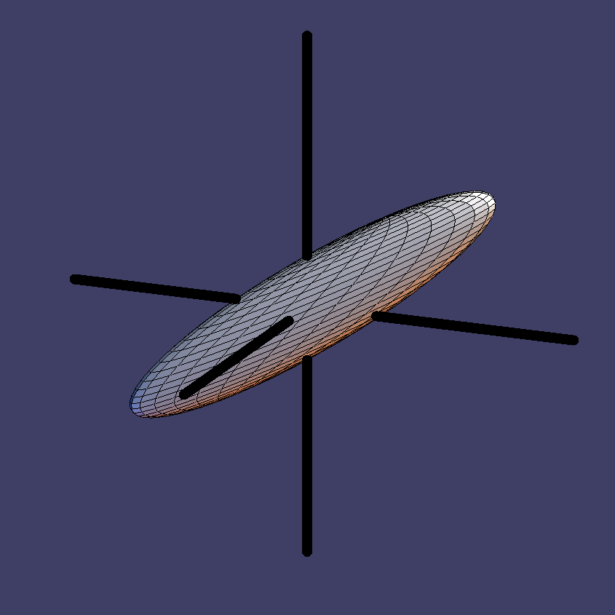
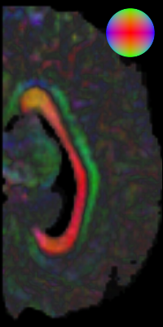
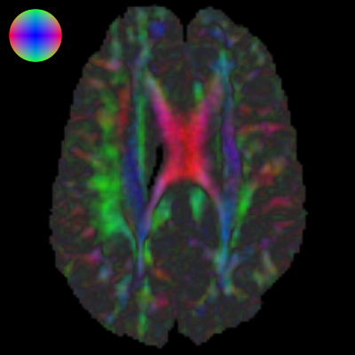
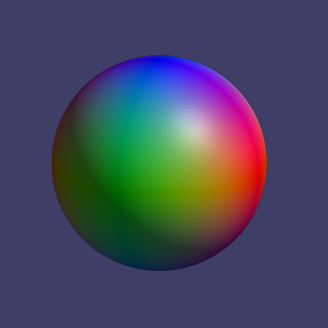
Colormap e1 (Pierpaoli ’97, Jones ’97)
Principal eigenvector, anisotropy
determine color
R=abs(x)
G=abs(y)
B=abs(z)
Slides borrowed from Dr. David S. Ebert

Slide 31
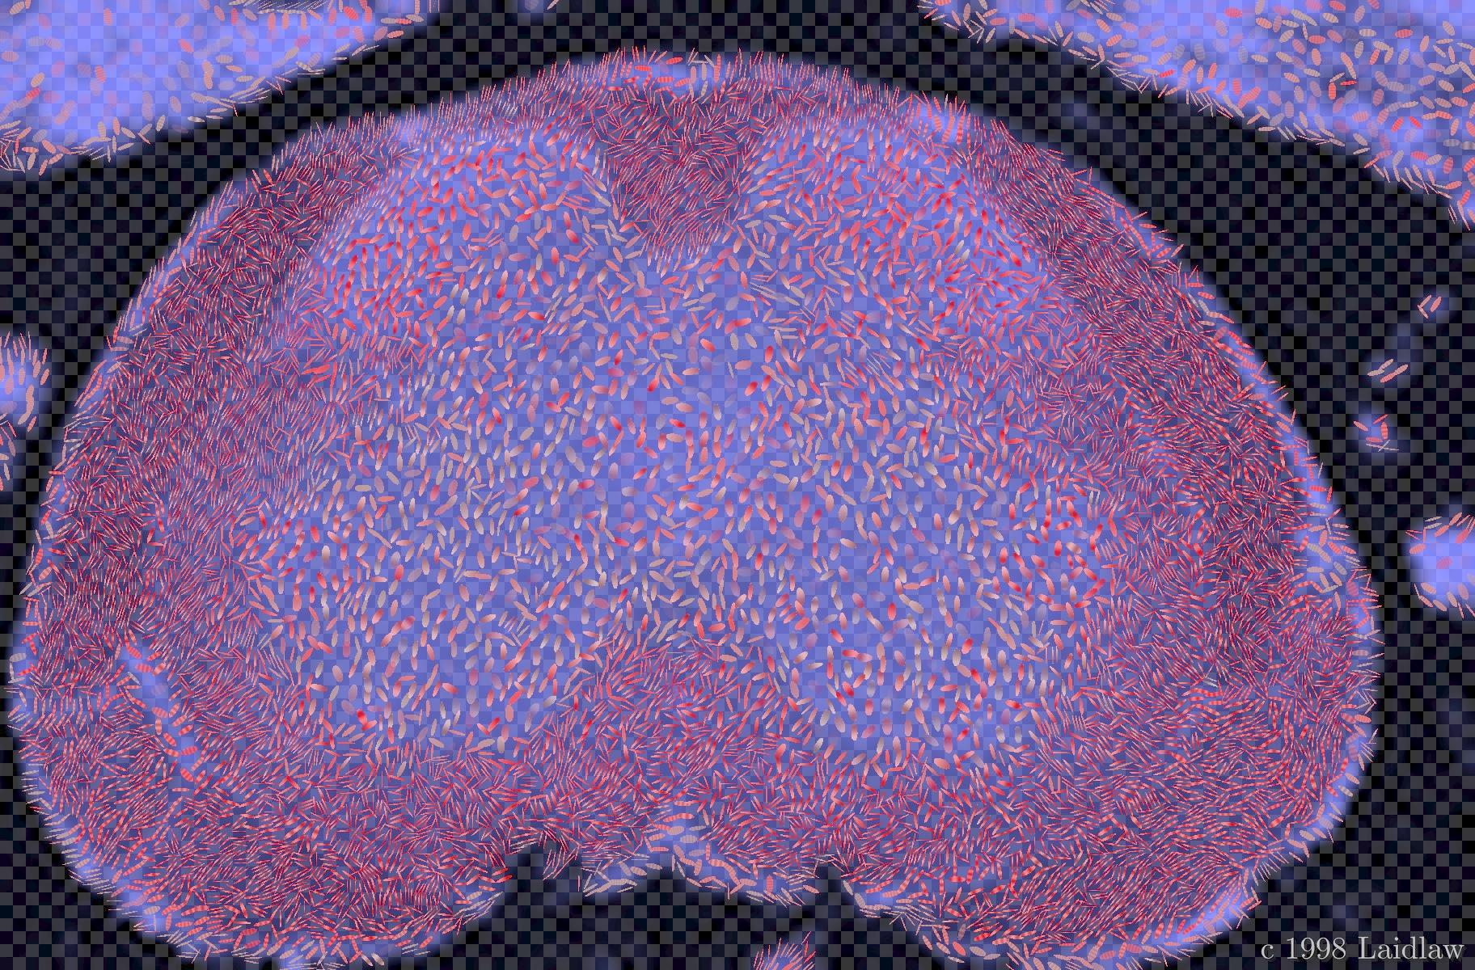

Brush Strokes (Laidlaw ’98)

Slide 32
Characterization of Visualization Techniques
3D data: particle traces
Particles trace out flow field
Mainly used for flow visualization
Slides borrowed from Dr. David S. Ebert

Slide 33
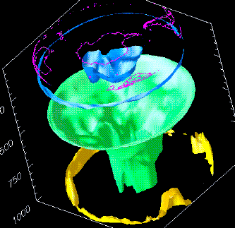
Characterization of Visualization Techniques
3D data: isosurfaces
Create surface from constant ranges in data
Has occlusion problems
Slides borrowed from Dr. David S. Ebert
Notes:
Iso-surface: The thresholds become the solid surface

Slide 34
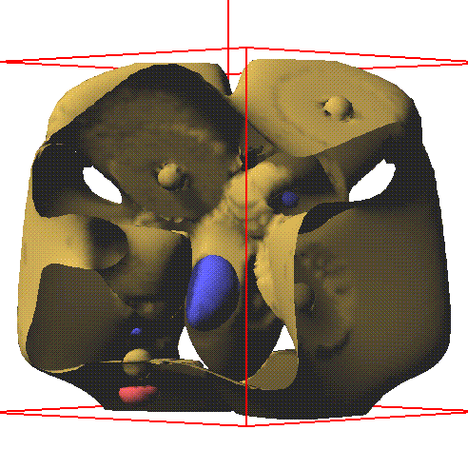
3D Scalar Field Visualization
Iso-contour surfaces
or
Iso-surfaces
Slides borrowed from Dr. David S. Ebert

Slide 35
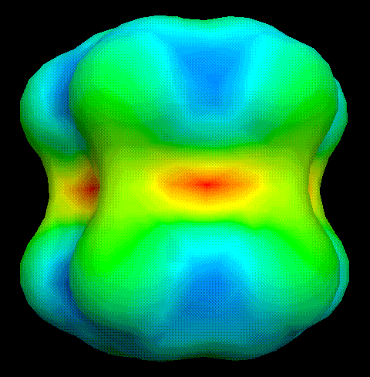
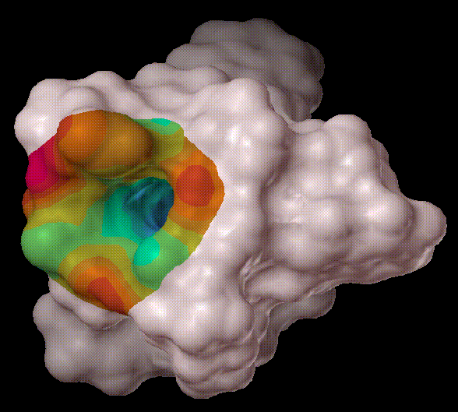
3D Visualization
Can add information about an additional variable
Here, two additional variables control the color.
Slides borrowed from Dr. David S. Ebert

Slide 36
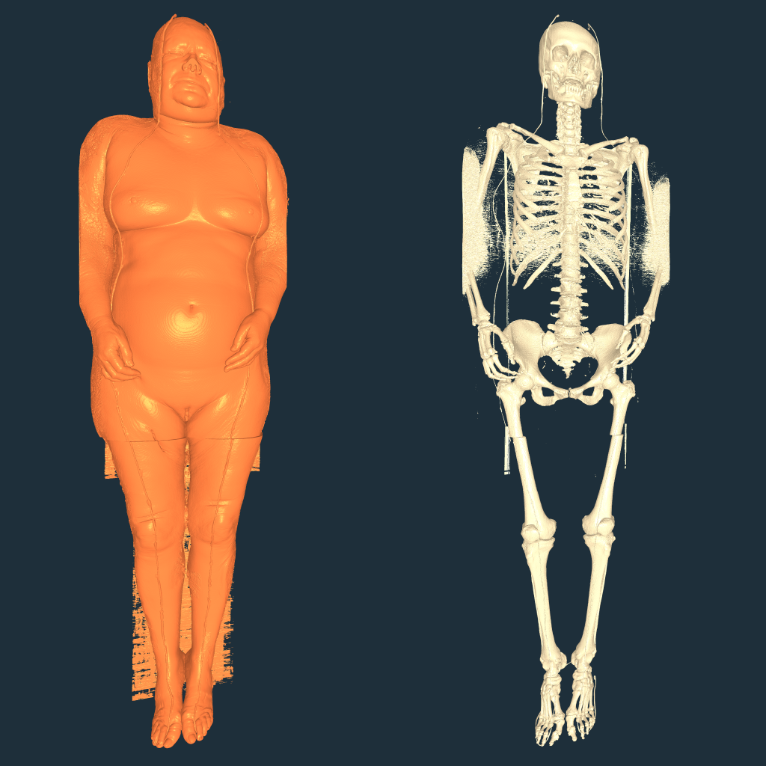
3D Scalar Field Visualization
Slides borrowed from Dr. David S. Ebert

Slide 37
3D Visualization
Can add information about an additional variable
Here, two additional variables control the color.
Slides borrowed from Dr. David S. Ebert

Slide 38
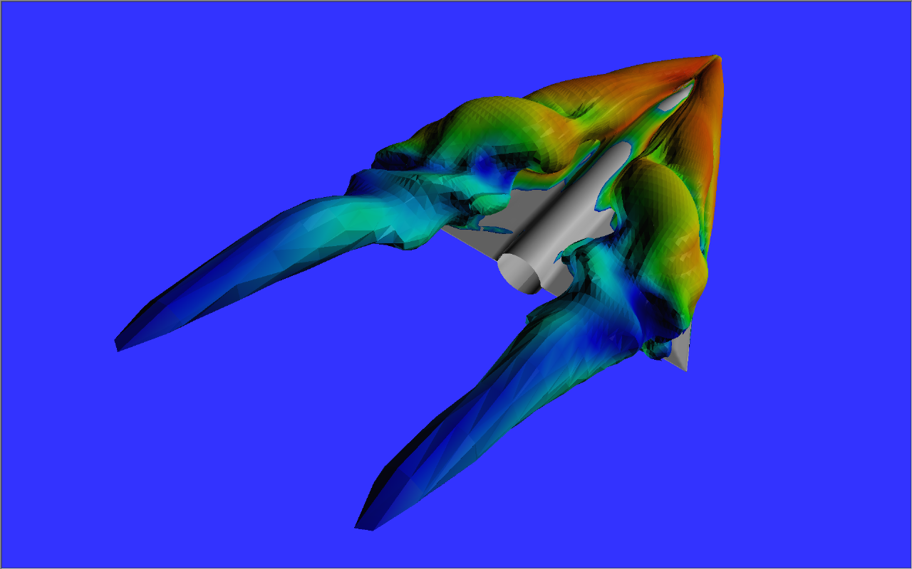
Derived Fields
Slides borrowed from Dr. David S. Ebert

Slide 39
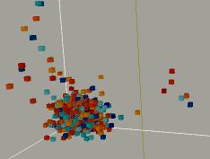
Characterization of Visualization Techniques
3D data: glyph rendering
Encodes multi-dimensional information
Advantages of volume rendering
Slides borrowed from Dr. David S. Ebert

Slide 40
Characterization of Visualization Techniques
3D data: volume rendering
Visualization of entire data volume
Map data values to opacity of volume elements
Techniques:
Volume tracing
Shear-warp factorization
Splatting
Hardware texturing
Slides borrowed from Dr. David S. Ebert

Slide 41
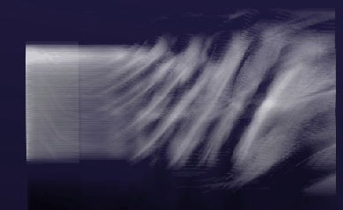
Characterization of Visualization Techniques
3D data: volume rendering
Slides borrowed from Dr. David S. Ebert

Slide 42
Surface vs. Volume Rendering
Surface rendering
Displays a subset of the data as surfaces
Multiple isosurfaces may be difficult to understand
Occlusion problems
Interactive rendering rate even on low-cost PCs
Volume rendering
Displays all of the data values selected
Truer representation of volumetric data
Transfer functions may be difficult to design
Difficult to get interactive rendering rates
Slides borrowed from Dr. David S. Ebert

Slide 43
Common Issues for All Types of Visualization Techniques
Accuracy of results
Accurate sampling
Hidden surface removal / rendering
Shading and illumination
Perception of information
User interaction
Slides borrowed from Dr. David S. Ebert

Slide 44
Sampling and Visualization
Sampling performed multiple times
Data acquisition
Segmentation / data pre-processing
Surface generation
Visualization / rendering
This information is vital to generating accurate images
Slides borrowed from Dr. David S. Ebert

Slide 45
Hidden Surface Removal (HSR) vs. Rendering
Rendering: taking a geometric description of objects / data and creating an image
HSR: determining which surface(s) is visible at each pixel in the image
Slides borrowed from Dr. David S. Ebert

Slide 46
Shading and Illumination
Shading: determining the color of each pixel
Includes: illumination, transparency, texturing, and shadowing
Illumination: simulating light reflectance, absorption, and transmission
Slides borrowed from Dr. David S. Ebert

Slide 47




Shading Example:
Slides borrowed from Dr. David S. Ebert

Slide 48
Perception’s Role in Visualization
Generating images for humans to view
Visual cues can increase effectiveness
Correct use of
Color
Lighting / shading
Shape / texture
Motion
Slides borrowed from Dr. David S. Ebert

Slide 49
Interactive vs. Non-Interactive
Interaction vs. image quality
Interaction vs. information quantity
More is not necessarily better
Best choice:
System that allows interactive preview and exploration combined with non-interactive realistic rendering
Slides borrowed from Dr. David S. Ebert

Slide 50
VR Approaches
Immersive
Isolates the user from environment
Expensive
Examples: Virtual Wind Tunnel, UNC, NRL, etc.
Slides borrowed from Dr. David S. Ebert

Slide 51
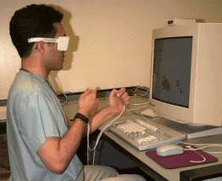
VR Approaches (cont.)
Minimally-immersive
Access to environment
Collaboration possible
Low cost
Two hands give proprioception
Examples: Hinckley et.al, Virtual Workbench, Responsive Workbench
Slides borrowed from Dr. David S. Ebert

Slide 52
Some Common Visualization Packages
IRIS Explorer (NAG)
Dataflow architecture
Supports
Isosurfaces
Streamlines
Volume rendering
Commercialized by NAG
Slides borrowed from Dr. David S. Ebert

Slide 53
Common Visualization Packages
AVS
One of the oldest packages & most popular
Supports
Isosurfaces
Streamlines
Volume rendering
Slides borrowed from Dr. David S. Ebert

Slide 54
Common Visualization Packages
IBM Data Explorer (Open DX)
Dataflow architecture
Supports
Isosurfaces
Streamlines
Volume rendering
Slides borrowed from Dr. David S. Ebert

Slide 55
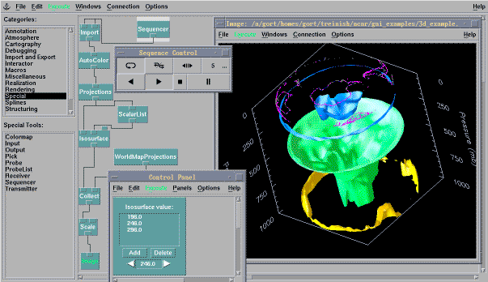
Common Visualization Packages
IBM
DX
Slides borrowed from Dr. David S. Ebert

Slide 56
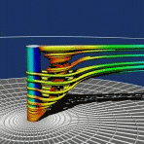
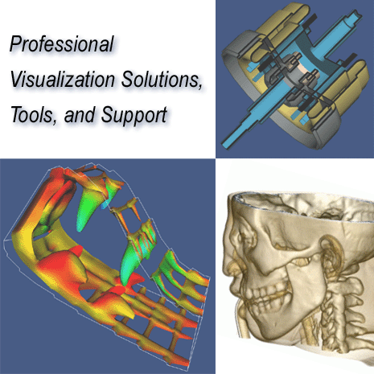
VTK (The Visualization Toolkit)
Programming interface using Tcl/TK, C++ or Java
Supports many rendering techniques
Can extend capabilities
Slides borrowed from Dr. David S. Ebert

Slide 57
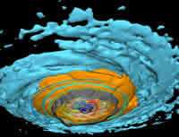
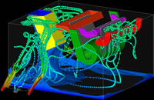
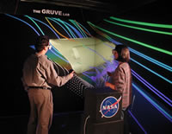
Common Visualization Packages
Ensight / CEI
End user package
Supports
Isosurfaces
Streamlines
Volume rendering
VR capabilities
Slides borrowed from Dr. David S. Ebert

Slide 58
Common Visualization Packages
Dataflow
Modeling
Simulation
Visualization
Slides borrowed from Dr. David S. Ebert

Slide 59
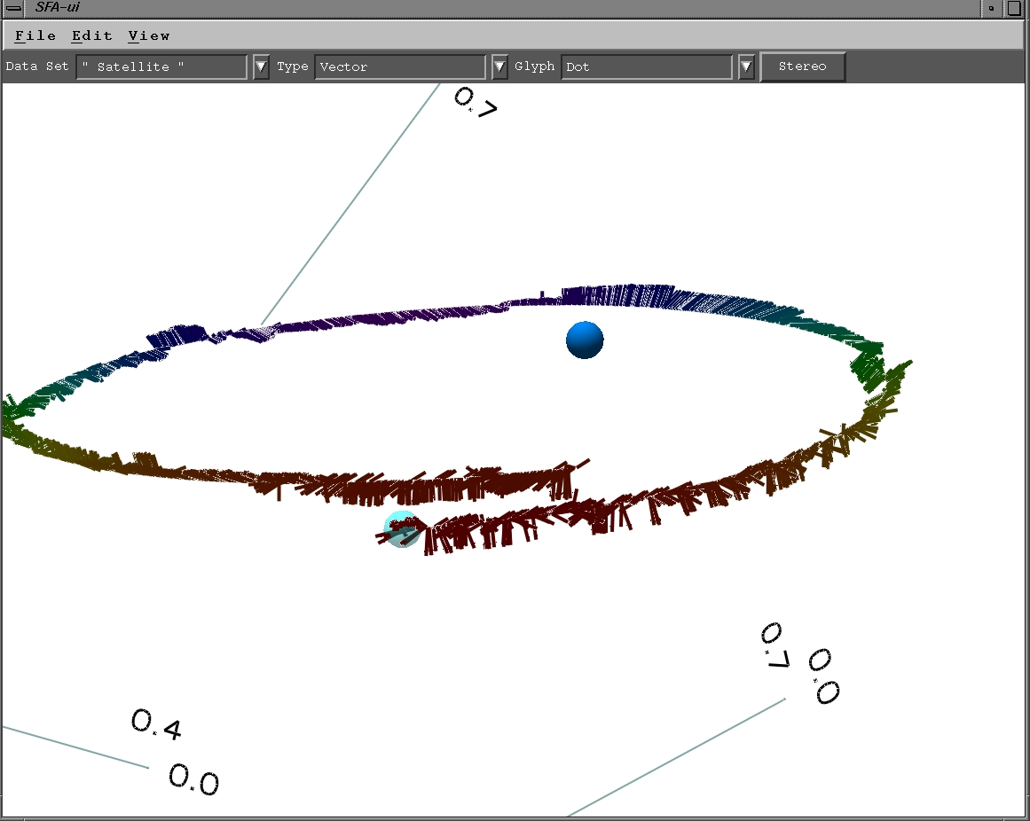
Example Research System: Our Glyph-based Visualization System- SFA
Glyph rendering
Data dimensions mapped to glyph attributes
Minimally-immersive VR interface
Multivariate, multidimensional time-varying data
Utilizes many perceptual cues
Slides borrowed from Dr. David S. Ebert

Slide 60
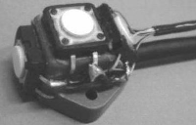
Minimally-Immersive User Interface - Fishtank VR
Advantages
Access to environment
Collaboration possible
Low cost (< $10K)
Implementation techniques
Stereo viewing
Two-handed interaction:
3-space trackers with buttons
Each hand has a distinct role
Left hand sets up context
Right hand performs fine manipulation
Slides borrowed from Dr. David S. Ebert

Slide 61
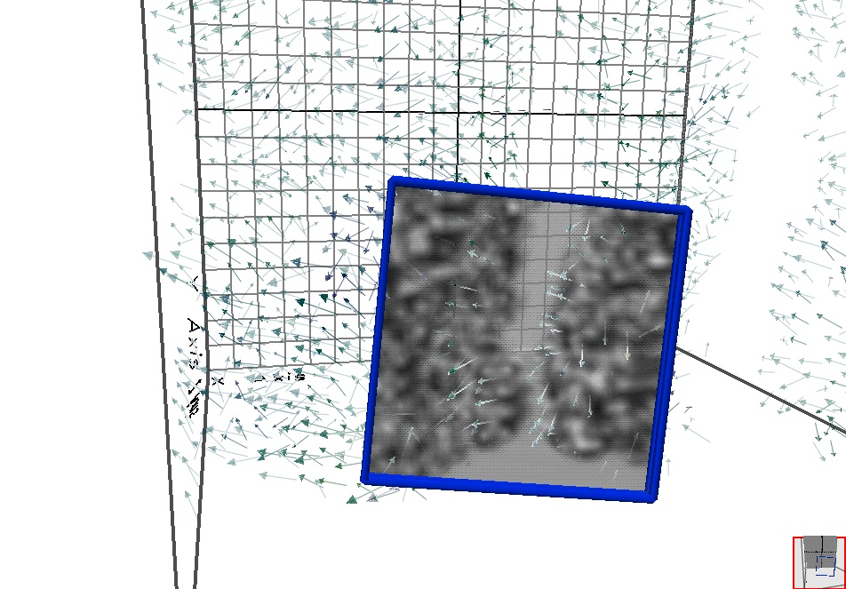
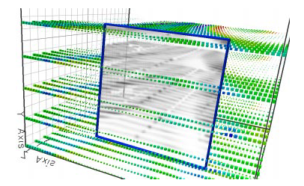
Interactive Lens Visualization Techniques (Ebert and Shaw)
Three types:
Contour plate
Texture-based volume rendering
X-ray projection (thin slab)
Allows display of more data variables/ dimensions
Solar Wind MHD Simulation Data
Slides borrowed from Dr. David S. Ebert

Slide 62
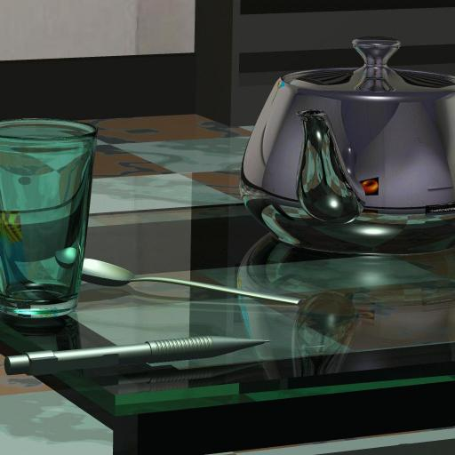
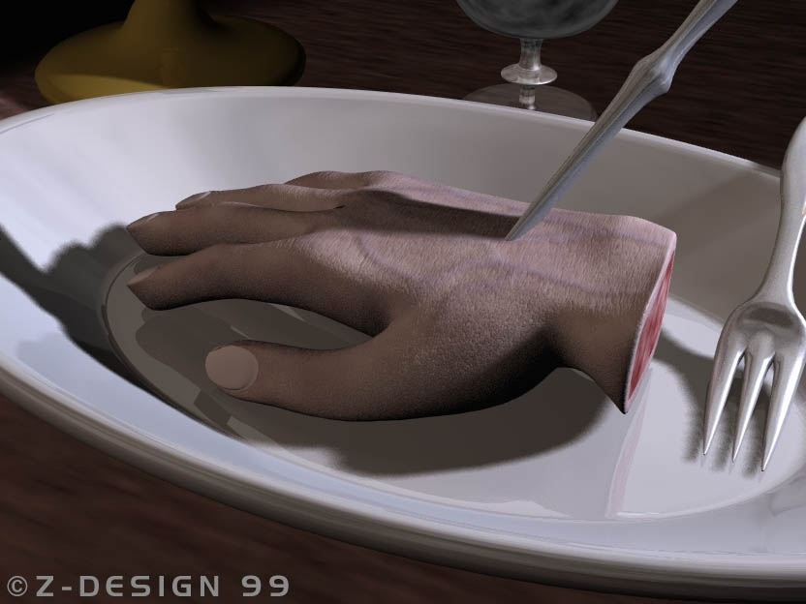
Related fields
Photorealistic rendering
The synthesis of an image of a scene as it would look like in reality
Slides borrowed from Dr. David S. Ebert

Slide 63
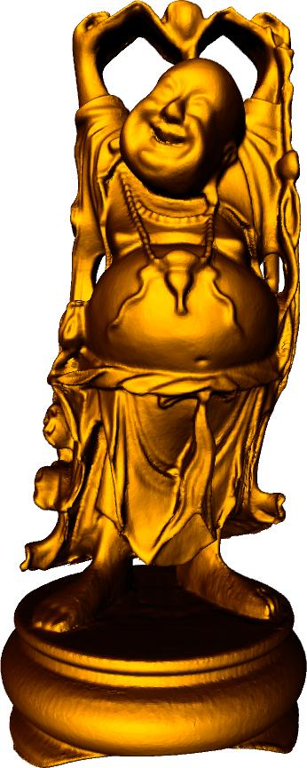



Related fields
Geometric modeling
The effective representation and efficient modification of geometric shape on a computer
Slides borrowed from Dr. David S. Ebert

Slide 64




Related fields
Image processing and computer vision
The manipulation of images and the extraction of object specific information from images
Slides borrowed from Dr. David S. Ebert

Slide 65
Potential for visualization
Effectively convey multifield three-dimensional, time-varying information
Interactive exploration and analysis
Closed loop exploration
Simulation −> visualization/exploration −> simulation
Simultaneous comparison of 4 to 7 variables
Spatial and abstract data
Error and uncertainty data
Slides borrowed from Dr. David S. Ebert
Notes:
Analyze first
Zoom in filter
Data extraction
Analyze again

Slide 66
Capabilities for Visualization
Advanced 3D visualization
Interactive volume rendering
Illustrative rendering enhancements
Isosurfaces
Particle clouds
Glyphs
Slides borrowed from Dr. David S. Ebert

Slide 67
Capabilities for Visualization
Animation
Stereo visualization
3D interaction and tracking
Haptics
Real-time interaction and exploration
Visual interface for computational steering
Slides borrowed from Dr. David S. Ebert

Slide 68




Advanced Real-time Volume Visualization Examples
Images from Kniss, Premoze, Hansen, Ebert, “Interactive Translucent Volume Rendering and Procedural Modeling,” IEEE Visualization 2002.

Slide 69



Interactive Visually Accurate Weather Visualization

Slide 70

Example: Interactive Volume Illustration
Images by Nik Svakhine
Slides borrowed from Dr. David S. Ebert

Slide 71


Iron Protein Molecule Normal Volume Rendering Tone Shaded .

Slide 72



Stipple Examples

Slide 73


Interactive Volume Illustration and Volume Stippling Results
Images by Nik Svakhine
Slides borrowed from Dr. David S. Ebert

Slide 74



Example: Volume Rendering vs. Isosurfaces
X38 re-entry vehicle flow simulation

Slide 75
Example: Minimally-immersive Visualization (Ebert and Shaw)
Solar Wind MHD Simulation Data
Glyph rendering
Data dimensions mapped to glyph attributes
Minimally-immersive VR interface
Multivariate, multidimensional time-varying data
Utilizes many perceptual cues
Combines multiple rendering modalities
Applications:
Scientific visualization (physics, CFD, comp. nanotechnology)
Information visualization (corpus vis, network intrusion detection)
Slides borrowed from Dr. David S. Ebert

Slide 76
CSE 591 Volume Visualization I
Ross Maciejewski
rmacieje@asu.edu

Slide 77


Slide 78


Slide 79


Slide 80


Slide 81


Slide 82


Slide 83


Slide 84


Slide 85


Slide 86


Slide 87


Slide 88


Slide 89


Slide 90


Slide 91


Slide 92


Slide 93


Slide 94


Slide 95


Slide 96


Slide 97


Slide 98


Slide 99


Slide 100


Slide 101


Slide 102


Slide 103


Slide 104


Slide 105


Slide 106


Slide 107


Slide 108


Slide 109


Slide 110


Slide 111


Slide 112


Slide 113


Slide 114


Slide 115


Slide 116


Slide 117


Slide 118
Readings and Homework
Required Reading:
Lorensen, W., and Cline, H. "Marching Cubes: A high Resolution 3D Surface Reconstruction Algorithm", ACM Computer Graphics, Volume 21, Number 4, 1987.
Penny Rheingans and David Ebert (2001), "Volume Illustration: Non-photorealistic Rendering of Volume Models," IEEE Transactions on Visualization and Computer Graphics, vol 7, no 3, July-Sept 2001, pp 253-264.
Homework
Homework #7 is assigned
Milestone #3 is due April 13th!

Slide 119
CSE 591 Volume Visualization II
Ross Maciejewski
rmacieje@asu.edu

Slide 120


Slide 121


Slide 122


Slide 123


Slide 124


Slide 125


Slide 126


Slide 127


Slide 128


Slide 129


Slide 130


Slide 131


Slide 132


Slide 133


Slide 134


Slide 135


Slide 136


Slide 137


Slide 138


Slide 139


Slide 140


Slide 141


Slide 142


Slide 143


Slide 144


Slide 145


Slide 146


Slide 147


Slide 148


Slide 149


Slide 150



Structuring Feature Space
Ross Maciejewski, Insoo Woo, Wei Chen, David S. Ebert

Slide 151
Transfer Function Design Is Hard!
Goal is to fit some sort of mathematical transformation to the data that will most faithfully recover essential features within this space
Current widgets rely on inherent data knowledge or trial-and-error

Slide 152










Transfer Function Design Is Hard!
Density vs. Density Gradient Normal Histogram Feature Space
Application of Transfer Function to Volumetric Data

Slide 153
Structuring Feature Space
Can we aid users in fitting appropriate mathematical functions to the feature space?
What is a plausible probability density function which describes the dataset?
Our approach is to use kernel density estimation.

Slide 154

Kernel Density Estimation
N = sample size
= distance from i^{th}
point to k^{th} nearest
neighbor
Epanechnikov Kernel

Slide 155



Enhancing Transfer Function Design
Density vs. Density Gradient Normal Histogram Feature Space
Color Transfer Function Via Density Estimation Grouping
Application of Transfer Function to Volumetric Data

Slide 156
Benefits of Structuring Feature Space
Allows users to gain an overview of which areas in the feature space map to volume features

Slide 157











Density Vs. Density Gradient
Generated Transfer Function
Initial Volume Rendering
Final Rendering and Transfer Function After Combining and Filtering Regions
Region Exploration Through Transfer Function Interaction

Slide 158
Benefits of Structuring Feature Space
Allows users to gain an overview of which areas in the feature space map to volume features
Allows for easier complex transfer function mapping

Slide 159



Benefits of Structuring Feature Space
Allows users to gain an overview of which areas in the feature space map to volume features
Allows for easier complex transfer function mapping

Slide 160





Benefits of Structuring Feature Space
Allows users to gain an overview of which areas in the feature space map to volume features
Allows for easier complex transfer function mapping

Slide 161














Exploring Feature Space

Slide 162





Changing Feature Space Axes
Electron orbitals of a two million atom Indium-Arsenic quantum dot device in the second state: (Left) the p orbital rendered using the p-value vs. p-value gradient feature space, (Right) using the p-value vs. s-value feature space.

Slide 163
Interactive Demo

Slide 164




Three Dimensional Transfer Function

Slide 165





Temporally Coherent Transfer Functions
165
1)
11)
21)
31)
41)

Slide 166


Slide 167









Temporally Coherent Transfer Functions
4380)
4500)
4620)
4740)

Slide 168












Static Vs. Dynamic Transfer Function
4500)
4620)
4380)

Slide 169

Future Work Directions
Appropriate distance metrics between features
How to improve understanding of n-dimensional transfer function
Can we “tag” voxels in temporal volumes to track features, or is that necessary?
Region growing may not be the interactions user wants
Can we associate some confidence, uncertainty and/or importance measure to a given cluster
Best distribution method (quantile measures?)

Slide 170


Questions?

Slide 171
Readings and Homework
Required Reading:
Ross Maciejewski, Wei Chen, Insoo Woo, David S. Ebert. Structuring Feature Space - A Non-Parametric Method for Volumetric Transfer Function Generation. IEEE Transactions on Visualization and Computer Graphics, 15(6): 1473-1480, Nov./Dec. 2009.

